Slide 1
Strategically supporting PrEP implementation for adolescents & young adults
.
Shona Dalal, PhD
24 July 2018
www.who.int

Slide 2
Recurring questions about PrEP for youth
Who are these young people who need PrEP?
Why do they get infected with HIV at such a high rate?
Where are they?
How do we reach them?
Is PrEP dangerous for young people?
Will they actually take a pill a day?
How can we give PrEP to those <18 years?
How do we measure how we’re doing if people can stop & start PrEP at will?

Slide 3
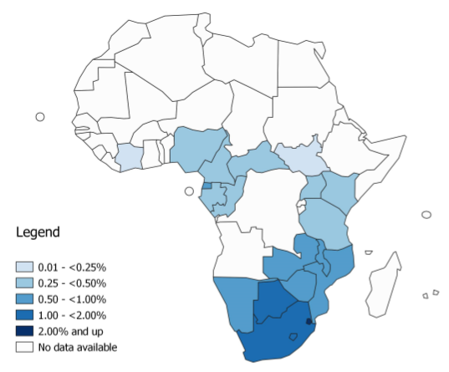
Pulling together what we know - 1
Who are these young people?
Aged ~15-24 years
Young key populations globally
Young women in particular in sub-Saharan Africa
Why do they get infected at such a high rate?
Biology
Behavior
Structural barriers
Social norms
Where are they?
Community
Health services (HTS, contraception, ANC, STI)
How do we reach them?
Create demand
Differentiate risk / Improve risk perception
Integrate services
Twenty countries with the highest HIV incidence rate among young women ages 15–24 years
Source: UNAIDS 2018 estimates

Slide 4
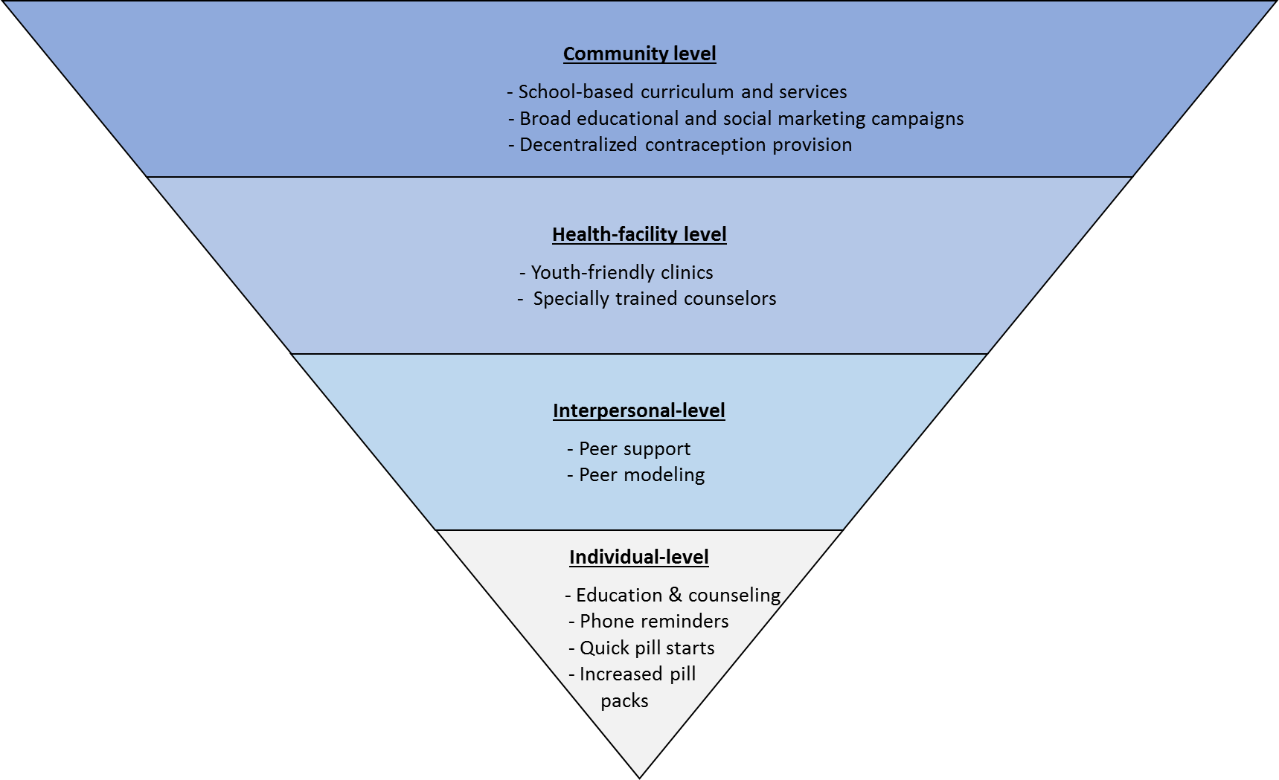
Pulling together what we know - 2
Is PrEP dangerous for young people?
Safe if >35 kg
Clinical considerations for BMD, kidney function, pregnancy & breastfeeding etc.
Will they actually take a pill a day?
Yes!
But continuation on PrEP is a challenge
Improve access –policy & structural barriers
How can we give PrEP to those <18 years?
With sensitivity & care
Support services
How do we measure how we’re doing if people can stop & start PrEP at will?
Disaggregate by 5 year age bands
Track outcomes – referrals, loss to follow up, adverse events
Review of interventions to improve uptake, adherence and continuation of oral contraceptives among youth
Source: Velloza et al., unpublished

Slide 5
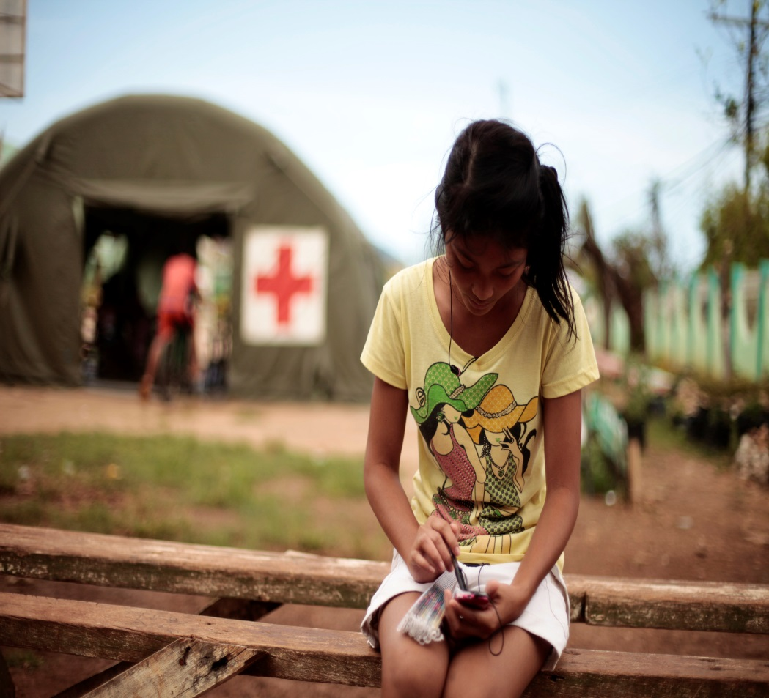
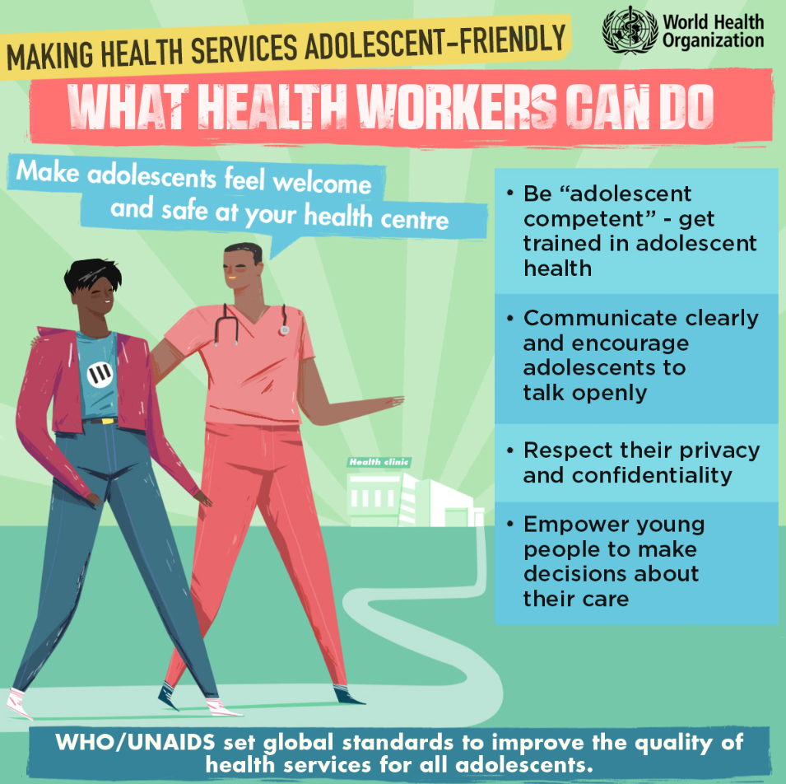

Slide 6
Acknowledgements
Bill Kapogiannis
Connie Celum
Linda-Gail Bekker
Sinead Delaney-Moretlwe
Sybil Hosek
Rachel Baggaley
Michelle Rodolph
Ioannis Mameletzis-Hodges
Module reviewers

